Slide 1
August 2020
Special Education In-Service

Slide 2

Emotional Disturbance criteria
For eligibility purposes, a student must meet at least one of the following characteristics:
Inability to learn that cannot be explained by intellectual, sensory, or health factors
Inability to build or maintain satisfactory interpersonal relationships with peers and teacher
Inappropriate types of behavior or feelings under normal circumstances
A general pervasive mood of unhappiness or depression
A tendency to develop physical symptoms or fears associated with personal or school problems

Slide 3
Emotional Disturbance criteria
The characteristic must be displayed:
Over a long period of time (generally at least 6 months)
To a marked degree (obviously more severe than peers)
And has a negative impact on student’s educational performance (academically, socially, behaviorally, adaptively, etc.)

Slide 4
An inability to learn that cannot be explained by intellectual, physical, or health factors
do not confuse with an unwillingness to learn
reality distortion
disorganized thoughts
difficulty retaining material; and factors such as a learning disability or ADHD have been ruled out

Slide 5
An inability to build or maintain satisfactory interpersonal relationships with peers and teachers
Unable to begin or keep friendships with peers and satisfactory relationships with teachers in MULTIPLE settings
The following behaviors may be seen in ED students:
Excessively controlling - ignored/rejected by peers
Lacks trust in others - unable to interact with a group
Wants constant approval - sees self as victim
Difficulty attaching to others - lacks social awareness
It is typical for ED students to have a better connection with special education teachers than general education teachers

Slide 6
Inappropriate types of behaviors or feelings under normal circumstances
- This does not include behaviors that are oppositional or conduct disorder. This does not include behaviors that are willful and understood by the student.
- May be expressed through confused verbalizations, fantasizing, emotional conflict in writing or art, and other outlets
- Includes behaviors that are bizarre or psychotic, such as compulsions, hallucinations, delusions, severe mood swings, and excessive preoccupations

Slide 7
Inappropriate types of behaviors or feelings under normal circumstances
More behaviors:
Reacts catastrophically to everyday occurrences
Engages in self-mutilation
Displays unexplained rage reactions or violent temper tantrums
Dwells in a fantasy life or seems out of touch with reality
Displays regressive behaviors when under stress
Shows manic reactions (unexplained euphoria, racing thoughts)
Has recurrent obsessions

Slide 8
A general pervasive mood of unhappiness or depression
To qualify ED, this must be seen in the school setting even if a medical professional has already diagnosed the student with a form of depression
Consider any context of the situation (death, divorce, etc.) and the intensity and duration
Characteristics may look like:
Lost interest in activities - Lost interest in social relations
Suicidal ideation - Recurrent thoughts about death
being emotionally numb - difficulty thinking or concentrating
Outbursts of excessive anger, frustration, irritability

Slide 9
A tendency to develop physical symptoms or fears associated with personal or school problems
Complains of physical problems without known medical cause (aches, pains, vomiting, etc.)
Displays physical reactions that seem linked to stress (sweating palms, increased heart rate, eye blinking, etc.)
Excessively fearful in response to new situations, certain people or groups, and/or certain classes or activities
Expresses fear of going to school, may even refuse
Has irrational fear that harm will occur to self or important people
Worries excessively about school performance, so much so that the anxiety causes an inability to perform to their level

Slide 10
Autism
The Individuals with Disabilities Education Act (IDEA) defines autism as a developmental disability significantly affecting verbal communication, nonverbal communication, and social interaction.
Other characteristics often associated with autism are: engagement in repetitive activities and stereotyped movements; resistance to environmental change or change in daily routines; and unusual responses to sensory experiences.

Slide 11
importance of teaching social skills
Students diagnosed with an Emotional Disturbance or Autism struggle with learning and using appropriate Social Skills
Social skills should be taught everyday.
Teaching appropriate social skills can help prevent negative behaviors
Ways to teach social skills:
  Social Stories
  Videos
  Role-Play real life scenarios
Pre-Teach social skills and behavior expectations prior to important/big events, such as, assemblies, special events, field trips, etc...

Slide 12
Visual Supports
Visual Supports are supports provided in the classroom and throughout the school environment to help support positive behavior interactions and teach social/behavior expectations
Visual Supports can be provided as:
  pictures (used primarily in lower grades PK/Kinder)
  pictures paired with text
  text (used primarily in upper grades and/or with higher level thinkers)

Slide 13
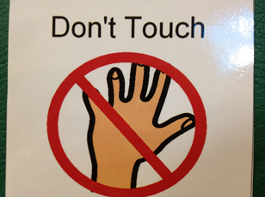
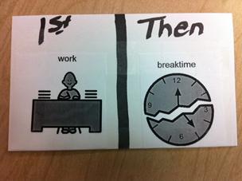
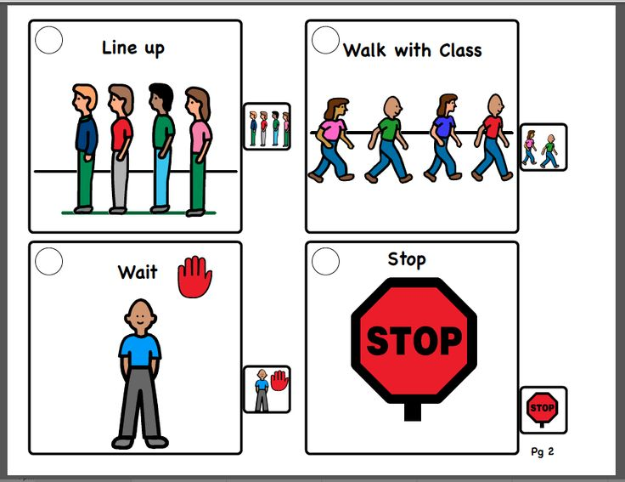
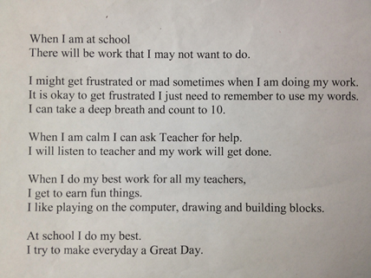
Antecedent visual supports
If/Then Chart
Social narratives
Visual Reminders
Video Modeling

Slide 14
Consequence Supports
Supports, often visual, provided in the moment (rather than before the situation) or after a challenging behavior occurs
Serve as reminders of expectations
Examples:
  Reminders that a break is coming
  Reminders
  Behavioral Map
  Token Board

Slide 15
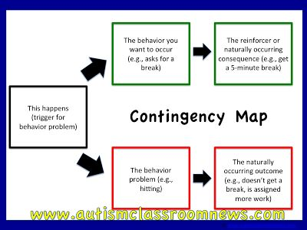
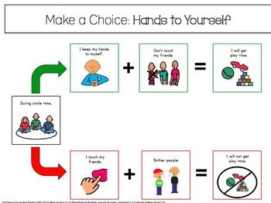
behavior maps
Behavior Maps are utilized as a visual to remind students that each choice has a consequence

Slide 16
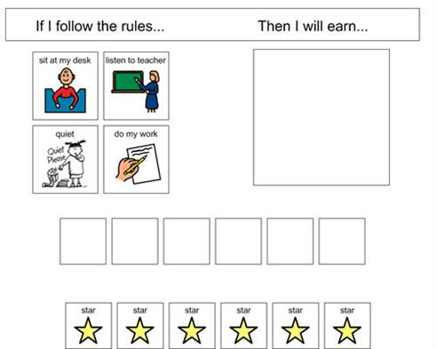
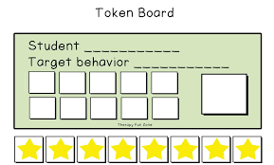
Token boards
Token Board:
  Set Clear Behavior/Task Expectations
  Tokens can be given after a task or after a set period of time that desired behavior has occurred (i.e. on task for 5 minutes)
  Students should know what is expected to earn a token and/or how often tokens will be given
  Token boards can be simple or personalized for each student.
  Students should choose the reward they are working for prior to the beginning of class or task.

Slide 17
Importance of Play and Sensory Breaks
Cognitive Benefits
Recess, whether performed outdoors or indoors, makes children more attentive (increases in sustained attention), less fidgety, and more productive in the classroom
(very noticeable differences in ADHD students)
- sustained attention helps support higher-order cognitive abilities such as language and memory
increases the ability to narrow-in on the relevant task at hand and disregard irrelevant distractions (such as background noise)
Students with an autism spectrum disorder: can improve their attention skills (shifting attention, joint attention, sustained)
For nonverbal students, sensory breaks can improve the ability to use and respond to visual cues and symbols

Slide 18
Importance of Play and Sensory Breaks
Social-Emotional Benefits
- opportunity to practice social skills and role-play with peers
- learn valuable communication skills (negotiation, cooperation, problem solving, etc.)
- Provides a mental break from academic challenges which can lead to an improvement in overall mood
- students with an autism spectrum disorder: gives them chances to practice social skills and to understand and relate to others in different environments

Slide 19
Alternative Discipline Options
Walking Ticket
- Teacher writes on the ticket how many minutes the student will be walking
- The student takes the ticket to recess.
- At the end of walking time period, the teacher initials the ticket
- The teacher keeps the tickets in student’s daily planner to track behavior over time (piece of data useful in parent communication)

Slide 20
Alternative Discipline Options
Zones
- When two students are not getting along, divide the playground into two zones
- On MWF, one student is allowed to only be in the swings/slides area while the other is only in the basketball court/open field area; T-Th locations are switched
- Throughout the days, mediate the relationship between the two and once they are ready to treat each other with respect, then you can take the zones away

Slide 21
Alternative Discipline Options
Check-In Check-Out on the Playground
At the start of recess, the teacher talks about previous inappropriate behaviors that needs to be corrected, discuss the replacement behavior, and has the student repeat the conversation in his/her own words (takes 30-60 seconds).
At the end of recess, the teacher reviews the student’s behavior for that time period (again takes 30-60 seconds)

Slide 22
Alternative Discipline Options
alternative punishments that can still provide opportunities for kids to move and get sensory input rather than just sitting at recess
  Taking part in a job that incorporates movement (wiping tables, stacking chairs, washing a window, etc.)
  Losing a specific (favorite) piece of playground equipment or a specific playground activity (basketball) for a day or two

Slide 23
Alternative Discipline Options
Logical consequences are directly tied to the behavior
  example of consequence directly tied to behavior: student is pushing peers on the playground Consequence: misses recess for a day or two and talks to an adult about the behavior/how to get attention from peers in a positive manner, etc. (conversation could take place during a walk to allow some movement during that time) because the misbehavior was at recess, it is appropriate to take away recess time
  example of consequence not directly tied to behavior -- Behavior: student makes a mess in the cafeteria Consequence: misses recess that day (instead, make the consequence tied to the cafeteria – thus, cleaning up area in the cafeteria

Slide 24
Behavior Intervention Plan (BIP)
Used to target challenging behaviors and implement replacement behaviors
Functional Behavior Assessment might need to be conducted prior to implementation
Consists of:
  Target Behaviors
  Replacement Behaviors
  Antecedents (what happens before the behavior occurs)
  Consequences (what happens after the behavior occurs)
  Interventions

Slide 25
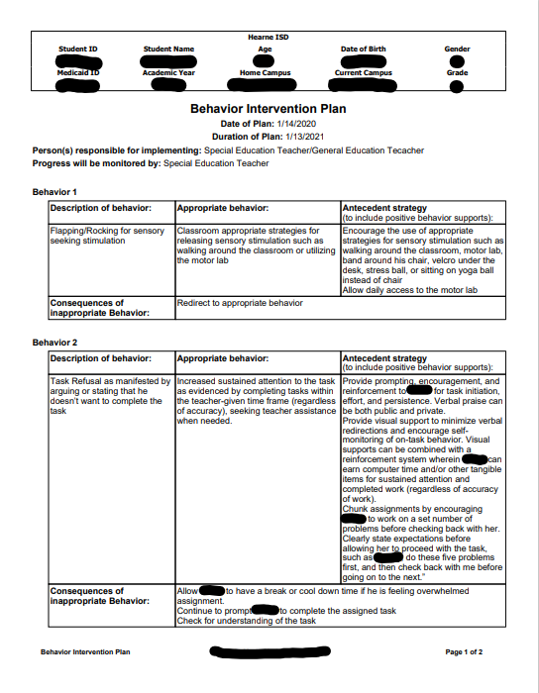
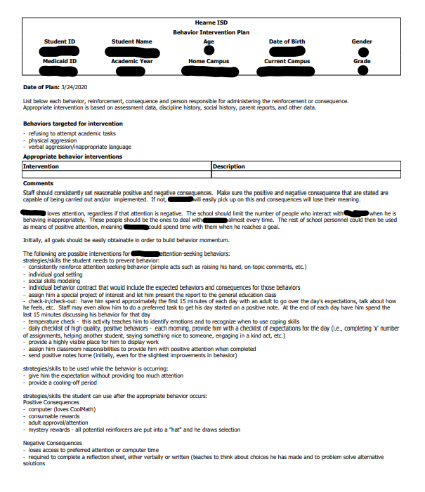

Slide 26
BIP
Classroom behavior interventions should be attempted before a BIP is put into place
  Attempts should be documented
ARD committee will meet to discuss possibility of a BIP
  LSSP will determine need for FBA/BIP
BIP is implemented
  Once BIP is in place, interventions should be utilized when student is exhibiting challenging behaviors
  Intervention reliability should be documented
  LSSP can be contacted for clarification or assistance with the interventions
BIP can be edited or removed at the student’s annual ARD
  Documentation will be necessary to edit BIP or to remove BIP

Slide 27
Implementation of the BIP
Person responsible: Special Education Teacher and General Education Teacher
SPED teachers should meet with Gen Ed teachers to review BIP and interventions every time the BIP is changed
DOCUMENTATION
  Effectiveness of BIP should be documented by all teachers
  SPED teachers should make sure Gen Ed teachers have a way to document that BIP is being utilized and effectiveness of BIP
  This will be critical to make changes to the BIP

Slide 28
Autism Supplement
All students with autism will have an autism supplement as part of their IEP
Overview of all interventions and supports that the child will need
Is updated at each annual ARD by the LSSP

Slide 29
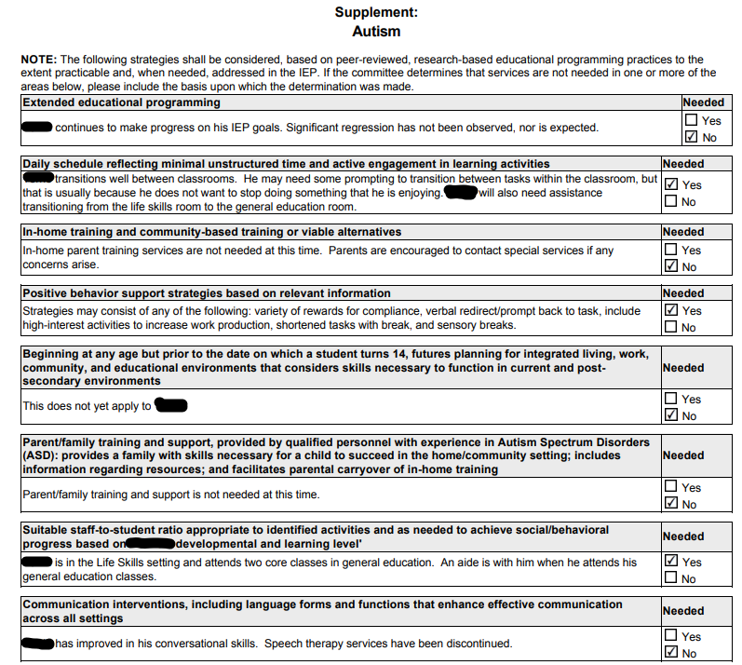
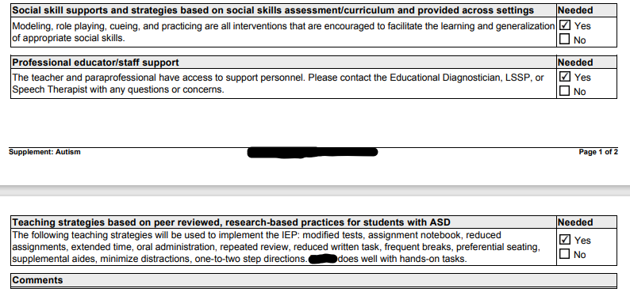

Slide 30
Autism Supplement
Extended Educational Programming
  If the student will benefit from ESY (documentation is required)
Daily Schedule reflecting minimal unstructured time and active engagement in learning activities
  If the student requires less unstructured time and needs to be engaged during more parts of the day
In-home training and community-based training or viable alternatives
  If parent needs in home parent training (provided by RCSSC)
Positive behavior support strategies
  PBIS information that can be used in the classroom setting
Transition
  Begins at age 14
Parent/family training and support
  If parent/family needs extra training and or support from RCSSC

Slide 31
Autism Supplement
Suitable staff-to-student ratio
  Academic placement for student
Communication interventions
  Will indicate if the student is receiving speech services and what speech interventions can be utilized in the classroom
Social skill supports and strategies
  Will indicate if the student is receiving social skill services and what interventions can be utilized in the classroom
Professional educator/staff support
  Indicates all staff have access to support in the form of LSSP, SLP, or Diagnostician
Teaching strategies based on peer reviewed, research ­based practices for students with ASD
  Teaching strategies that should be utilized in the classroom for that student

Slide 32
Resources
Free Online Webinars:
  ONLINE TRAINING in AUTISM
  For Teachers
  https://www.educationcorner.com/behavioral-disorders-in-the-classroom.html
Free Downloadable Resources:
  Free Downloads
Social Skills Videos:
  WonderGrove Kids
  https://www.youtube.com/playlist?list=PL6RcrKwPxzWwUHC7CxHwSb3On_dP0EOt9

