Slide 1
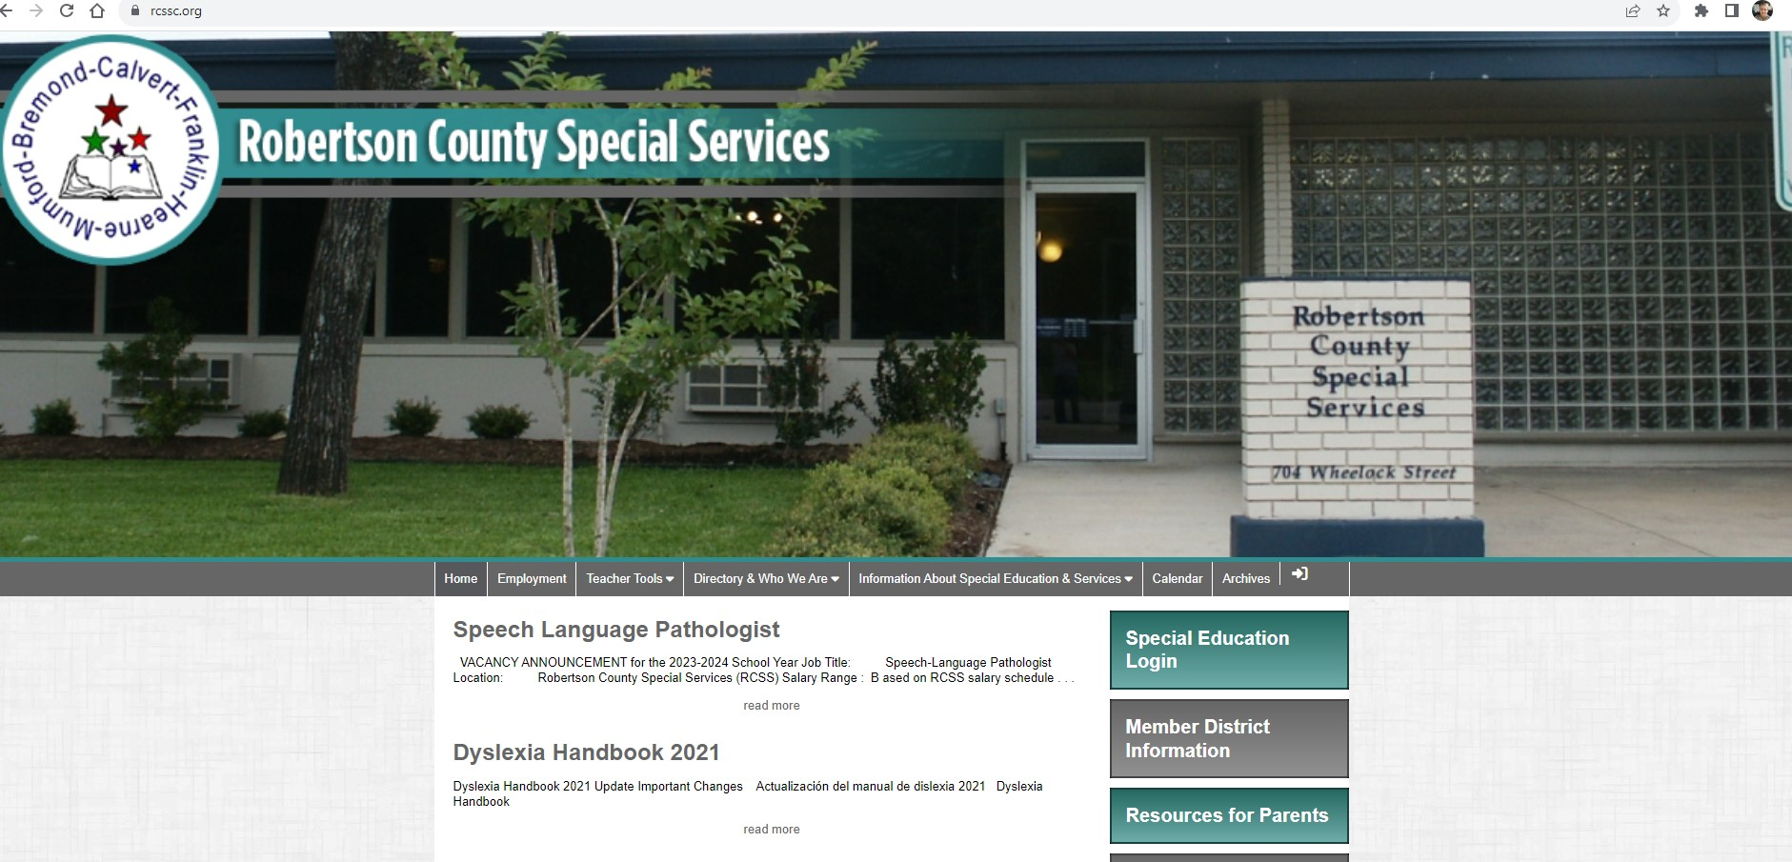

Empower Every Ability

Slide 2


Slide 3



Slide 4
IDEA makes sure that the ARD reviews an FIE to develop an IEP that ensures FAPE in an LRE.
Following an FIE, that may include an FBA, children can be identified as SLD, ED, OHI, DHH, VI, AU, ID, OI, SI, TBI, or any combination of these.
Services may include OT, PT, AI, VI, O & M, AT, and/or a BIP.

Slide 5
Major Points of Special Education
Locate – Identify – Provide services

Slide 6
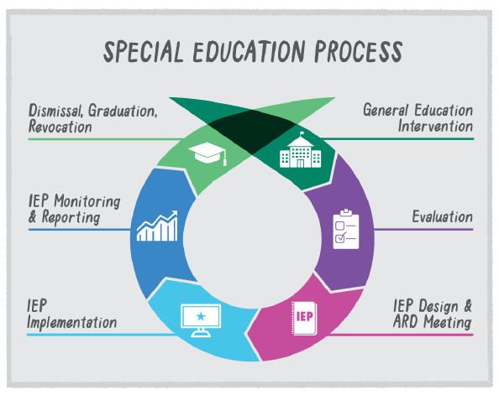
RtI or MTSS
FIE

Slide 7
What have you tried? How successful?
Provide input
Provide input
Read & understand the IEP. Implement & document.
Participate – input & perspective

Slide 8

We are obligated to keep our eyes open for students with possible disabilities.
We then must start the referral process to RtI, Section 504, or Special Education.
Evaluation consists of data collection from a variety of sources.

Slide 9

Child Find
The Federal Law (Individuals with Disabilities Education Act (IDEA) requires each state to put processes in place which ensure each district meets its Child Find Duty.
The Child Find Duty states: All children with disabilities residing in the state, regardless of the severity of their disabilities, and who are in need of special education and related services, must be identified, located, and evaluated.
https://childfindtx.tea.texas.gov/

Slide 10
Key Elements of Child Find
Any child between the ages of 3 and 21 suspected of having a disability and in need of special education and related services (including dyslexia)
Includes students enrolled in private schools or homeschooled
Includes students who are homeless, and/or wards of state
Anyone can initiate a child find request
Parents/Guardians & Adult Students are protected by due process when the Child Find duty is not executed correctly

Slide 11
Child Find
If a parent submits a written or verbal request for a full and individual initial evaluation (FIIE), the LEA must respond to the request not later than 15 school days from the date the request is received by providing the parent with prior written notice (PWN), a copy of the Notice of Procedural Safeguards, and the opportunity to give written consent for the evaluation. Or the LEA must provide the parent with PWN refusing the evaluation and a copy of the Notice of Procedural Safeguards.

Slide 12
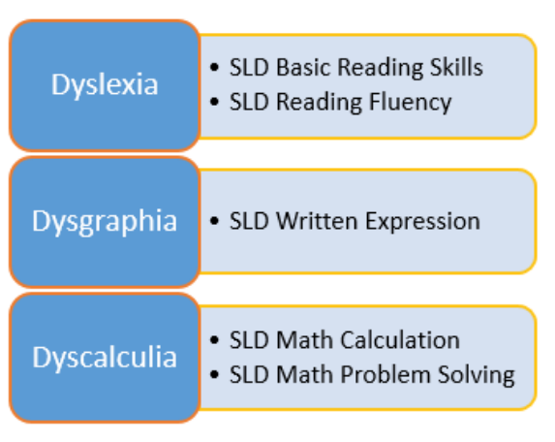
Dyslexia
Dyslexia is a specific learning disability. Therefore, the evaluation/identification of dyslexia is treated the same way as other IDEA eligible disability categories in terms of the referral process.
Anytime the LEA suspects or has reason to suspect that a student has dyslexia or a related disorder, and needs services, the LEA must seek parental consent for a full individual and initial evaluation (FIIE) under the IDEA.
Notes:
If an LEA suspects, or has reason to suspect, a student has dyslexia and may be a child with a disability under IDEA An FIIE is recommended. Parents are provided: • Prior Written Notice (PWN) • Notice of Procedural Safeguards • Overview of Special Education for Parents form • Opportunity for parent to provide written consent to evaluate When formal evaluation is recommended, the school must complete the evaluation procedures as outlined in the IDEA.

Slide 13
Conduct an Evaluation (FIE)
AU – Autistic OI – Orthopedic Impairment
DB – Deaf/Blind OHI – Other Health Impairment
DHH – Deaf/Hard of Hearing SLD – Specific Learning Disability
Dyslexia or Related Disorders SI – Speech Impairment
ED – Emotional Disability TBI – Traumatic Brain Injury
ID – Intellectual Disability VI – Visual Impairment
MD – Multiple Disabilities
NCEC – changing to Developmental Delay(ages 3-9)

Slide 14
ARD Meeting is Scheduled and Eligibility is Decided
Within 30 calendar days from the date of the completion of the initial evaluation report.
If the 30th day falls during the summer and school is not in session, the student’s ARD committee has until the 15th day of classes in the fall to finalize decisions concerning the student’s initial eligibility determination, IEP, and placement.

Slide 15
ARD Committee Meeting Agenda
Introduction and statement of purpose
  Admission
  Review
  Dismissal
Review assessment data
  Information from parents
  Information from school personnel
  Information from other sources
  Determination of the student’s eligibility

Slide 16
ARD Committee Meeting Agenda
  Needs/Development of IEP
    Review previous year IEP objectives
    Competencies
      Physical
      Behavioral
      Prevocational
      Academic/Development
    Summarize Needs
    Write/approve new objectives
    Schedule of services
    Related services
    State mandated testing and other required testing
  Determination of placement
  Justifications
  Assurances - Procedural Safeguards
  Closing statements and signatures
  Adjourn

Slide 17
Transition/Graduation
Transition services must be in place on or before the student’s fourteenth birthday.
Postsecondary goals
CTE representative will be invited to annual meetings
Outside agencies invited with consent
Texas Transition and Employment Guide on the district website.
https://spedsupport.tea.texas.gov/resource-library/texas-transition-and-employment-guide
Personal Graduation Plan

Slide 18
A Free and Appropriate Public Education (FAPE)
Students receive individualized specialized supports and services based on their disabilities and educational/social needs. (IEP)

Slide 19
34 Code of Federal Regulations § 300.320 Definition of individualized education program.
34 CFR §300.320 requires that a student’s IEP include a statement of measurable annual goals, including academic and functional goals designed to meet the student’s needs that result from the student’s disability to enable the student to be involved in and make progress in the general education curriculum and meet each of the student’s other educational needs that result from the student’s disability.
IEP must include a description of when periodic reports on the progress the child is making toward meeting the annual will be provided (at least every 6 weeks).
Document that Progress Reports have been sent each 6 weeks.

Slide 20

Development of the IEP
34 CFR §300.324 requires that, in developing each student’s IEP, the IEP team must consider the strengths of the student, the concerns of the parents for enhancing the education of their student, the results of the initial or most recent evaluation of the student, and the academic, developmental, and functional needs of the student. The IEP team must in the case of a student whose behavior impedes the student’s learning or that of others, consider the use of positive behavioral interventions and supports, and other strategies, to address that behavior.
Each LEA must ensure that the IEP team reviews the student’s IEP periodically, but not less than annually, to determine whether the annual goals for the student are being achieved and revises the IEP, as appropriate, to address any lack of expected progress toward the annual goals and in the general education curriculum, if appropriate.

Slide 21


Slide 22


Slide 23
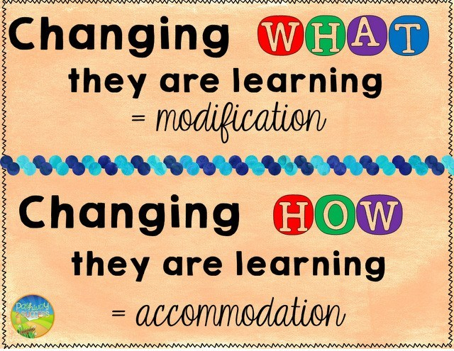

Slide 24

MODIFICATION
typically happens in a specialized setting.
Content is below grade level and specialized instruction is necessary to make gains.

Slide 25

ACCOMMODATION
happens anywhere.
Content is at grade level, but instruction and assessment is adapted to account for the student’s disability.

Slide 26

Notes:
Accommodation plans are not to be confused with an “all-you-can-eat” buffet.
Just because you CAN, doesn’t mean you SHOULD.
Its all about providing the level playing field for the students and NOT to allow an unfair advantage over the student’s peers.

Slide 27
When IEPs must be in effect.
34 CFR §300.323 requires that, as soon as possible, following the development of the IEP, special education and related services are made available to the student in accordance with the student’s IEP.
Compensatory Services-educational services needed to make up for skills or learning that have been lost when services described in an IEP were not provided.
Students Who Transfer-the LEA must provide FAPE to the child (including services comparable to those described in the child’s IEP from the previous public agency), until the new public agency either-
(1) Adopts the child’s IEP from the previous public agency; or
(2) Develops, adopts, and implements a new IEP that meets the applicable requirements in §§300.320 through 300.324.

Slide 28
Transfer Students
ESY- transfers in ESY-the new district must provide it or contract with the previous district
Transfer Information Forms
Request for Records
ARD-20 school days
Transfer Process for Campuses
Once you are aware that the student received special education services from the previous district:
1. Call your assessment staff at 979-279-3507 immediately.
2. Complete the Transfer Information Packet (PEIMS clerk/registrar).
Steps to follow
Give the parent the letter on the front of the Transfer Information packet.
Procedural Safeguards (pink)-Give this to the parent to keep
Receipt for Notice of Procedural Safeguards (pink)-Parent signs this/keep this copy
Notice for Release/Consent to Request Confidential Information-have parent sign this/keep this copy
Transfer Information
Write down the student's information-the address is very important (if this is on the enrollment form, you can just attach it)
List the unique ID and local ID (this is used to enter the student in SuccessEd)
Write down the name of the previous district
Verify that they received special education services
List handicapping condition
Attach a copy of the student's schedule
Return the completed packet to the RCSS office as soon as possible.
Transfer-20 day timeline starts when we receive the paperwork

Slide 29
Supplementary Aids and Services
The admission, review, and dismissal (ARD) committee must determine needed supplementary aids and services to be provided to the child, or on behalf of the child.
The term supplementary aids and services means aids, services, and other supports that are provided in regular education classes, other education-related settings, and in extracurricular and nonacademic settings, to enable the child with a disability to be educated with nondisabled children to the maximum extent appropriate.
Schools are required to implement the supplementary aids and services only as they are defined in the student’s IEP.
Notes:
Overcome the Fairness Challenge
Create and Implement Effective Educational Programming for Disabled Students

Slide 30
What does it all mean?
A student’s IEP must be followed exactly as it’s written.
Example: A child has 30 minutes of resource for math each school day.
Can we provide more than 30 minutes of resource time for math each school day? No.
Can we provide less than 30 minutes of resource time for math each school day? No.
What if the special education teacher is absent? Services must still be provided or the district could owe compensatory services.
If a student needs more or less support an ARD must be held to make the change.
Notes:
Understand the IDEA duty of FAPE

Slide 31
Least Restrictive Environment (LRE)
Educate special needs students with nondisabled peers as much as is appropriate.
YOU will provide input as to strengths and needs for your subject

Slide 32


Follow Legal Procedures
Timelines
Notifications
Parental Consent
Discipline Issues
IEP Implementation
Lack of Progress
Meetings
Transition Services
Etc.

Slide 33
Grading and Progress Monitoring 34 CFR §300.324
A student’s progress or mastery toward his/her IEP goals is never the basis for his/her grade.
Goals designate the necessary learning for the student to ensure access to and progress in the general curriculum as well as resulting in the student’s attainment of standards set out as critical in his/ her PLAAFP.
LEAs report students’ progress towards mastery of their IEP goals through IEP progress reports. This is its own process and is separate from reporting students’ grades.
Mastery of an IEP goal does not constitute passing a course, and passing a course does not equate to mastering an IEP goal
Data collection should begin as soon as the IEP is developed and continue until the next scheduled IEP review.
Usually progress is reported at the same time that typical students receive report cards, but this can change based on an ARD/IEP committee decision.
Notes:
Instructional and related service personnel collect and maintain records to chart the student’s progress and needs.

Slide 34
Grading and Progress Monitoring
Should a teacher give a zero for work that is missing or incomplete?
While there is no statute that prohibits the use of zeros in grading, teachers should assign a student an “incomplete” for work that the student does not turn in or that is unsatisfactory, and allow him/her to complete the work before, during, or after school, during lunch, or in other settings. This practice will allow for a more accurate reflection of what the student does or does not know.

Slide 35
Lack of Progress 34 CFR §300.324
The ARD committee must revise the IEP as appropriate to address any lack of expected progress toward the annual goals and in the general education curriculum, where appropriate.
If the student with disabilities fails to make progress on the IEP, the responsible teacher will review the IEP for appropriateness of goals/objectives, instructional materials and methods. The teacher must document the efforts made to try to help the student achieve success.
If a student with disabilities is not progressing toward mastery of the goal by the annual ARD, the ARD/IEP committee must convene to discuss the student’s needs and make recommendations to assist the student.

Slide 36
Discipline
DISCIPLINARY CHANGE OF PLACEMENT-10 consecutive school days or series of removals total more than 10 school days in a school year. 34 CFR §300.536
MDR-A manifestation determination must be made within 10 school days of any decision to make a disciplinary change of placement of the child with a disability because of a violation of a code of student conduct. 34 CFR §300.530
FUNCTIONAL BEHAVIORAL ASSESSMENTS (FBAs) AND BEHAVIOR INTERVENTION PLANS (BIPs)-not later than the 10th school day after the change in placement.
Alternatives to DAEP, OSS and ISS

Slide 37
Key Changes to ISS under HB 6
No time limits on ISS placements: Schools can now keep students—including those in special education—in ISS as long as deemed necessary, provided an administrative review occurs every 10 school days to confirm continued appropriateness and educational progress.
Out-of-school suspensions capped at 3 days: OSS for any student, including those with disabilities, is limited to a maximum of three consecutive school days.
Threat assessments for special ed students: If a student in special education is involved in a behavioral threat assessment, team composition must include professionals knowledgeable about that student’s disability (e.g., special ed teacher, behavior coach).
Disciplinary metrics excluded from accountability: The Texas Education Agency will exclude special education ISS and OSS rates from accountability calculations under the Results-Driven Accountability system, meaning districts won’t be penalized based on these removal rates.

Slide 38
Parental Involvement
Parents have the right to “meaningful participation” in all decisions regarding their children.
Assessment Services
Placement Goals
Notes:
Establish and maintain good relationships with parents
Recognize and respect the difficulty of raising a disabled child
Always remember that tone matters

Slide 39

You may not be in the ARD meeting
In order to make appropriate decisions,
Notes:
Teacher input forms.

Slide 40

- to the disability
- to the student
- to the subject
- to the activity

Slide 41

professional
COUNTS!
In evaluations, re-evaluations, and annual reviews.
YOUR INPUT drives the decision-making and development of the IEP.
Notes:
It is VERY important that you complete the Teacher Input form so that the committee has an accurate picture of what is happening in your class.
We are currently receiving a lot of Teacher Input forms where no “Problem Areas” or “Areas of Concern” are checked – AND the only comments are that he/she is doing well in class.
The Teacher Input form needs to correlate with the student’s disability and your subject matter.
The input that you provide drives the development of the IEP.

Slide 42


If you see a support that is no longer necessary, please
As kids mature, they learn coping skills that sometimes allow them to succeed without as much support.

Slide 43


So… how does this affect you?
You MUST keep your eyes and ears open to students who may have disabilities.
Notes:
So how does this information apply to you?

Slide 44


You MUST understand the information in the IEP and provide the listed accommodations and supports.
Follow the IEP!

Slide 45





Contact Logs
You need to document when/how you provided the accommodations and supports.
(work samples, lesson planning, pre- and post- evaluation conferencing, contact log, accommodation log, yellow folder)

Slide 46



Monitor:
IEP Progress-Academic and Behavior
Grades
Discipline Removals Approaching 10 Days
Attendance
Accommodations/Modifications
Etc.
Call an ARD When Needed!!

Slide 47


You need to provide accurate, specific feedback at annual meetings …
Show Me The Data!
Come Prepared

Slide 48


We are here to help.
You must have an ARD to make changes to the IEP.
If you are not sure about something, ask.

Slide 49


Slide 50


Slide 51


Slide 52
References/Resources
TEA and Education Service Center, Region 20 Grading and Progress Monitoring for Students with Disabilities
Region 18 Legal https://fw.esc18.net/display/Webforms/ESC18-FW-Landingpage.aspx
https://spedsupport.tea.texas.gov/
https://www.spedtex.org/
https://texasprojectfirst.org/
Safe and Supportive Schools | Texas Education Agency
Dyslexia Handbook
https://tea.texas.gov/academics/special-student-populations/special-education/texas-dyslexia-handbook.pdf
Standards Based Individualized Education Program (SBIEP) Process Training:
https://spedsupport.tea.texas.gov/learning-library/standards-based-individualized-education-program-iep-process-training
TA: Individualized Education Program (IEP) Development:
https://spedsupport.tea.texas.gov/resource-library/technical-assistance-individualized-education-program-development

